Slide 1
Crime pattern Mining
By Aashrith Maisa & Sai Mourya Buchi

Slide 2
Introduction & Problem Statement
Contextualizing crime rates as a reflection of socioeconomic dynamics.
Highlighting the significance of California's new theft law threshold of $950.
Investigating whether legislative changes correlate with crime rate fluctuations.
Investigating associations among various demographic attributes of victims and the nature of crimes committed against them.
Analysing the impact of the COVID-19 pandemic on crime rates within the state of California
Notes:
5th bullet point: In the end also include and explain about "and the subsequent alterations in the composition of criminal activities".

Slide 3
Methodologies
Apriori and FP-growth algorithms to mine frequent patterns relating to crime demographics and types.
Clustering to segment crime data into coherent groups for analysis.
Time series modeling to understand the changes in trend and seasonality.
Training LSTM on data from 2010 to 2014 to predict the effect of revised proposition 47 for years 2024 to 2025

Slide 4
Data Collection & Pre-processing
Data collected from Data.gov with metrics on theft, demographics, and dates.
Cleaning involved removing incomplete records and standardizing category definitions.
Normalization to account for population differences across cities.
The datasets collected especially on LA is from 2010 to 2023 which contains nearly 3 million crime incidents.

Slide 5
Pre-processing
Using bucketing techniques, categorized the continous values of age into three broad categories.
Using the notion of minority groups, categorized the races of victims into four broad groups.
Using the geographical sense, categorized the areas into seven groups.
Notes:
We have used the help of google maps and chatgpt to fine tune the area categories
Looking at histogram of age, we have made three braod buckets of age

Slide 6
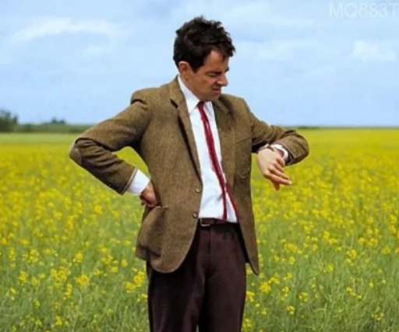
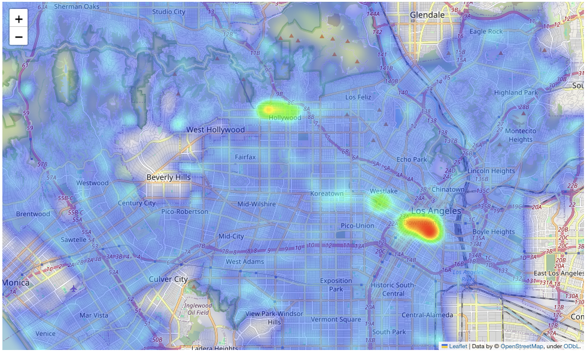
Visualization of data
Notes:
Most of the crimes occur in downtown and in central LA region

Slide 7

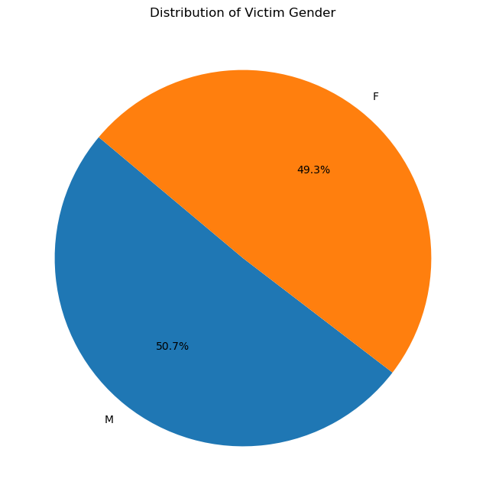
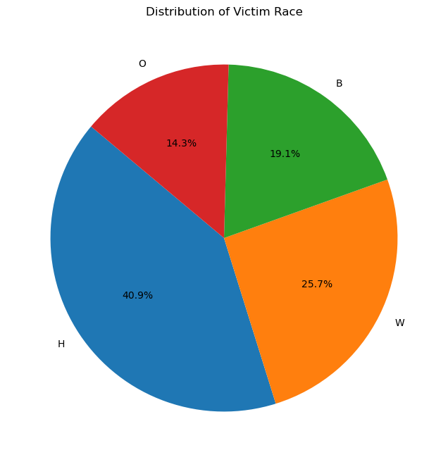
More Visualizations.....
Notes:
The plots are for pre covid data which have distributions of victim gender and age

Slide 8
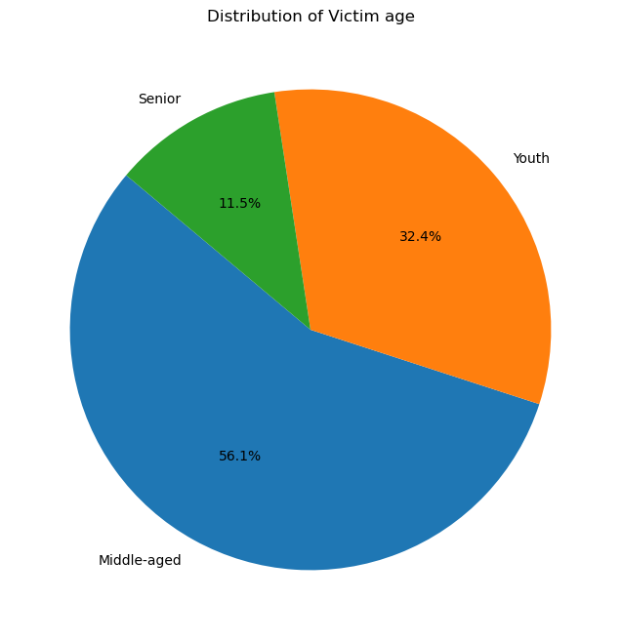
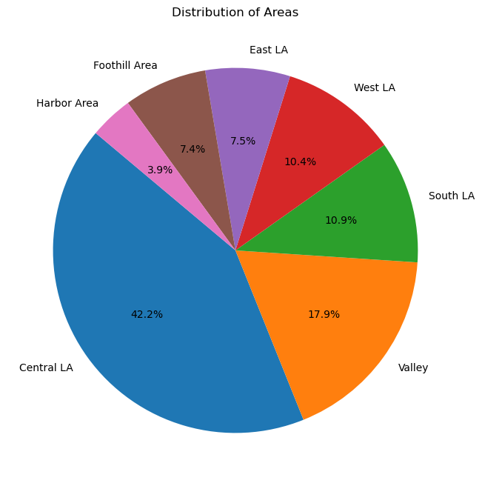
AND MORE...
Notes:
Distributions of age and areas

Slide 9
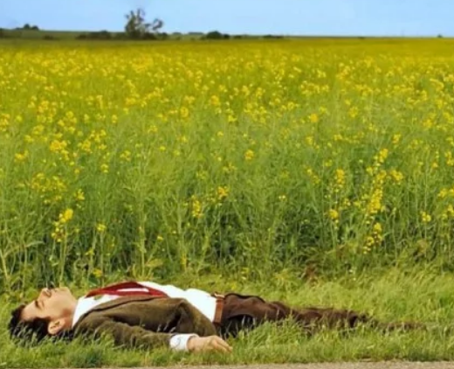
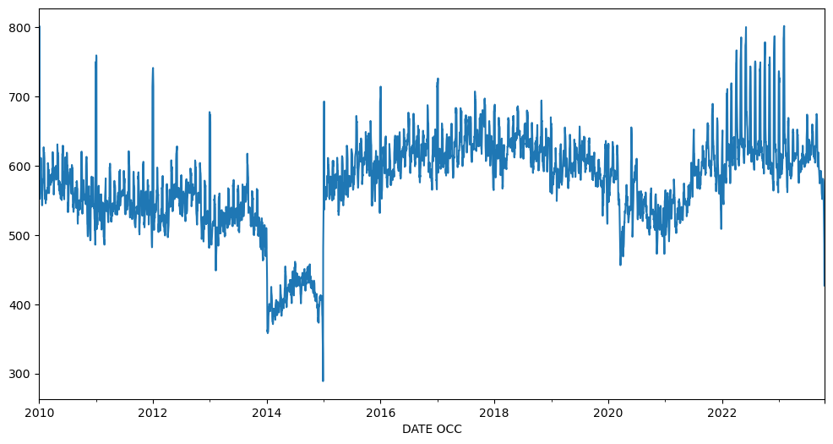
And more.....

Slide 10




Categorizing crime
There were a total of 138 different crimes identified from the dataset.
Categorized them into 9 broad categories for better visualization and understanding.
The categories include Violent crimes, Property crimes, Sexual offenses, White-Collar crimes etc.

Slide 11


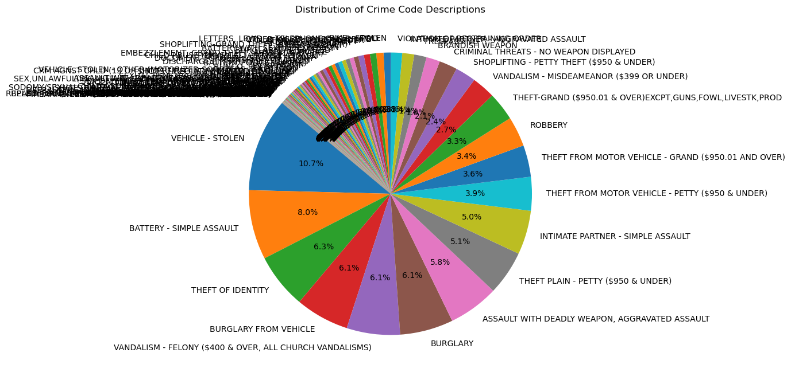
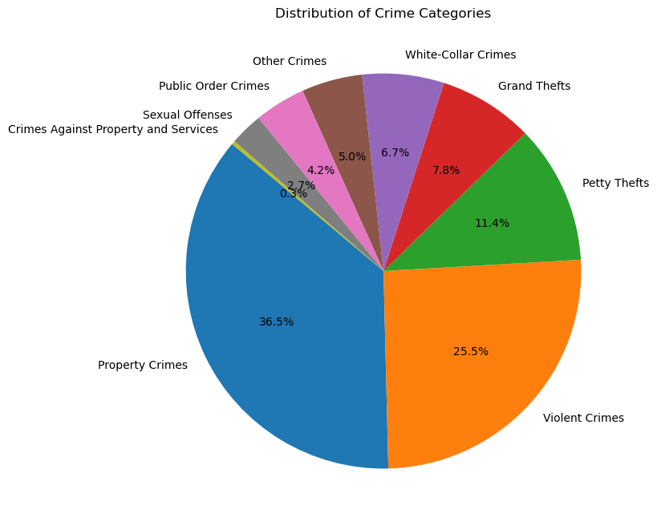
Visualizations of categories

Slide 12
PATTERN MINING
Using FP-growth, identified frequent itemsets and association rules.
Minimum support was set low to unearth frequent patterns.
Confidence of the rules were found out to understand their significance.
Notes:
Did not use apriori as it was taking long time

Slide 13
Interesting patterns
One of the interesting frequent pattern is that of the crime being "Battery", the gender of victim being Male, and the race of the victim being Hispanic.
Another interesting pattern is that of the crime being "Simple Assault by Intimate partner", the gender of the victim being Female, and the race of the victim being Hispanic.
There were several other interesting patterns were revealed which were containing two elements.

Slide 14
Interesting rules
One of the interesting rule is given the crime occurred is Grand theft from a vehicle, we can say that the victim's gender is Male with a confidence of 59%.
Another interesting rule is given the crime occurred is Theft of Identity, we can say that the victim's gender is Female with a confidence of 58%.
There are several other interesting rules which have unearthed by training the algorithm.

Slide 15
Dissimilarity between FI SETS
Used FOCUS metric to evaluate dissimilarity between pre-covid and post-covid FI (Frequent Item sets) sets. Obtained a value of 0.5 for it explaining some dissimilarities between both the periods.
By evaluating between the period before 2014 and period between 2014 and 2015, we got a value of 0.7 explaining lot of dissimilarities between both the periods
Petty thefts were prominent between 2014-2015 because of implementation of Proposition 47.

Slide 16
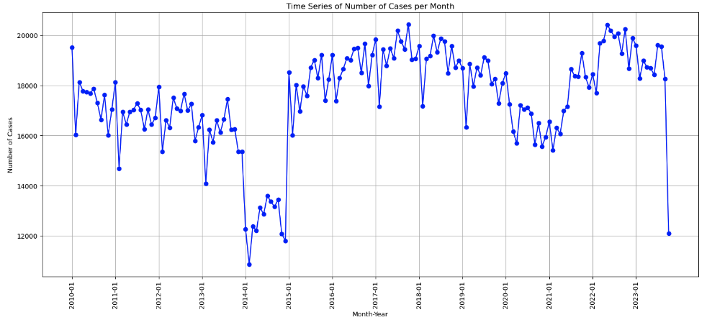
Understanding Crime Trends in Los Angeles
There is a significant decrease in the crimes after the Proposition 47 was passed in 2014 as many felonies were being started to be considered as misdemeanors which can be seen in the below graph

Slide 17
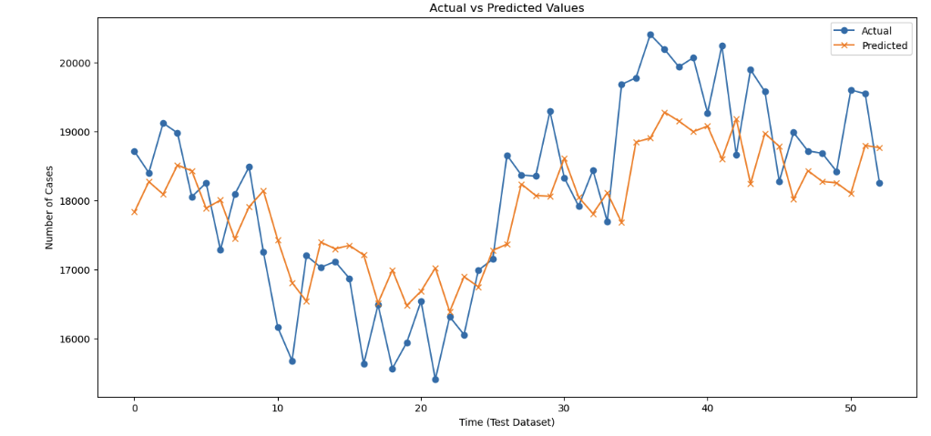
Implementing lstm to predict crime trend
The LSTM is trained on the data from 2010 to 2014 as the Prop 47 was implemented then the prediction was validated with the actual data of 2015 to 2016 which gave a RMSE of 876
Then it is used to predict the crime rate of 2024 to 2026 by further training on data of 2020 to 2023

Slide 18
FUture work(Can be done)
Utilizing demographic data to form clusters representing victim profiles.
Comparative analysis to identify unique and shared crime trends across the studied cities.

Slide 19

Thank you

